Slide 1

Vendor Performance & Inventory Optimization Analysis
Unlocking profitability through strategic vendor management and inventory optimization. This comprehensive analysis reveals $2.71M in locked capital and identifies critical opportunities to maximize margins while reducing operational inefficiencies.

Slide 2
EXECUTIVE SUMMARY
The Opportunity: $2.71M in Locked Capital
Our analysis uncovered significant capital inefficiencies driven by low-turnover vendors and under-promoted high-margin brands. The business must strategically reallocate marketing budgets toward high-margin "Target Brands" while reducing bulk orders from vendors contributing to dead stock.
Key Findings
$2.71M tied in unsold inventory
72% cost reduction through bulk purchasing
Low-volume vendors maintain 40%+ margins
Top 10 vendors drive 65.69% of purchases
This report evaluates vendor performance and inventory health across 10,000+ transactional records, revealing actionable insights for profit maximization and cost reduction.

Slide 3
METHODOLOGY
End-to-End Data Pipeline Architecture
To ensure robust and scalable analysis, we executed a comprehensive four-phase data transformation workflow:
01
02
Data Architecture & Centralization
Data Transformation & Aggregation
Established a localized relational database (inventory.db) to ingest and centralize fragmented datasets, mapping relationships across Sales, Purchases, Vendor Invoices, and Purchase Prices containing 10,000+ records.
Engineered SQL extraction pipeline using Common Table Expressions (CTEs) and complex LEFT JOINs to aggregate multilevel data into a comprehensive "Source of Truth" summary table.
03
04
Data Cleaning & Feature Engineering
Statistical Analysis & Insights
Developed Python-based processing to clean aggregated data, handle missing values, and engineer critical KPIs including Gross Profit, Profit Margin, Stock Turnover Ratio, and Sales-to-Purchase Ratio.
Applied advanced statistical methods including correlation analysis, confidence intervals, and hypothesis testing to extract actionable business intelligence.

Slide 4
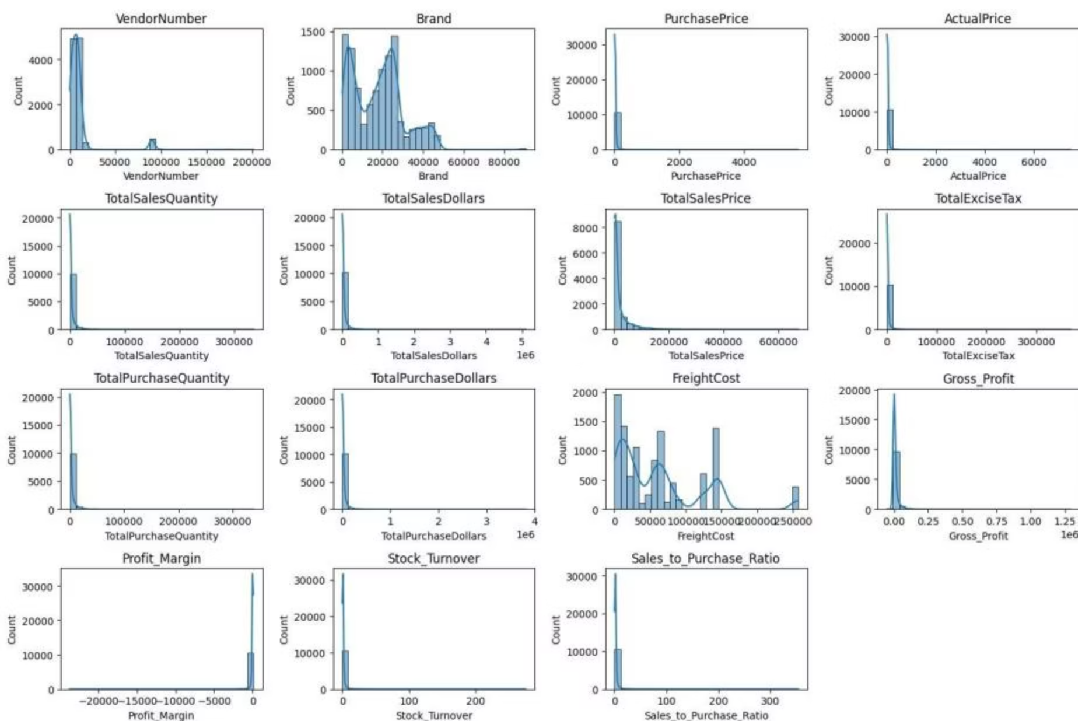
Data Distribution Reveals Critical Patterns
Negative Values Alert
Zero Sales Products
Extreme Outliers
Turnover Variance
Gross Profit minimum: -$52,002.78, indicating severe losses from products selling below cost due to aggressive discounting.
Minimum sales quantities of 0 reveal slow-moving or obsolete stock contributing to the $2.71M locked capital.
Freight costs range from $0.09 to $257,032.07, suggesting logistics inefficiencies requiring immediate audit.
Stock turnover spans 0 to 274.5, with values >1 indicating sales fulfilled from older inventory rather than recent purchases.

Slide 5
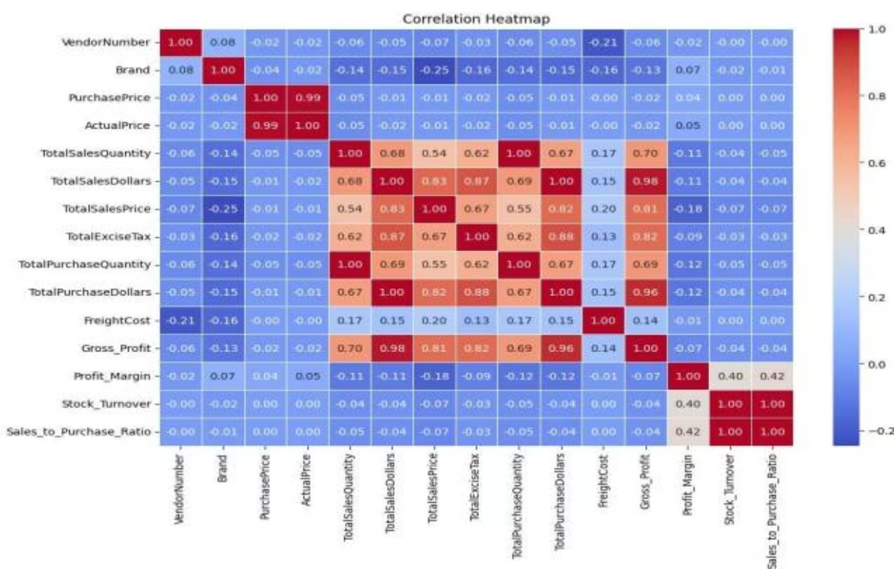
Correlation Analysis: Key Relationships
Critical Insights
Purchase Price Independence: Weak correlations with Total Sales Dollars (-0.012) and Gross Profit (-0.016) prove base price variations don't dictate revenue outcomes
Efficient Turnover: Strong correlation (0.999) between purchase and sales quantity confirms efficient inventory management
Pricing Pressure: Negative correlation (-0.179) between profit margin and sales price suggests competitive market forces
Turnover Paradox: Weak negative correlation (-0.055) between stock turnover and profit margin shows faster movement doesn't guarantee higher profitability

Slide 6


KEY FINDING
The Bulk Purchasing Advantage
72% Cost Reduction Through Volume
Vendors purchasing in bulk achieve the lowest unit price at $10.78 per unit, representing a substantial 72% reduction compared to small orders at $39.06 per unit.
This dramatic price elasticity demonstrates that bulk pricing strategies successfully encourage larger orders, increasing total sales while maintaining profitability despite lower per-unit revenue.

Slide 7
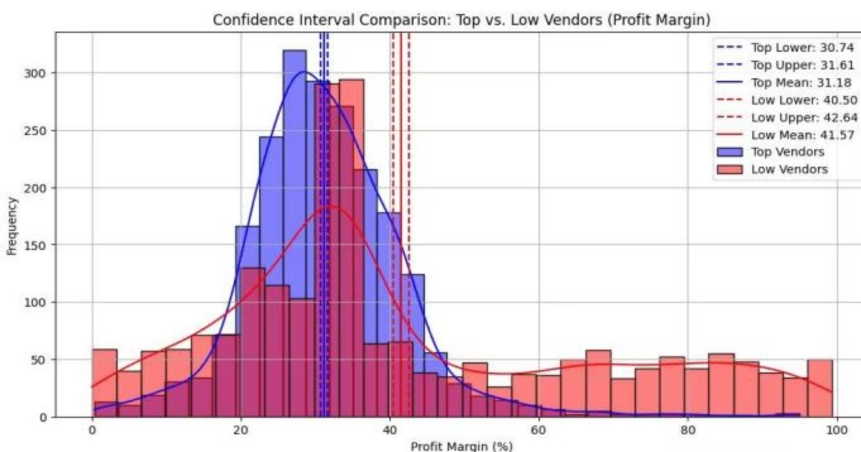
The Profitability Paradox
Hypothesis testing revealed a statistically significant divergence in how top-performing and low-performing vendors generate profit.
Low-Volume, High-Margin Vendors
High-Volume, Thin-Margin Vendors
95% CI: 40.48% - 42.62% | Mean: 41.57%
95% CI: 30.74% - 31.61% | Mean: 31.18%
Low-performing vendors maintain premium pricing models or possess lower operational overhead. 198 brands exhibit this pattern and could benefit from targeted marketing to increase volume without compromising profitability.
Top-performing vendors operate on thinner margins, relying on high-volume turnover. They could explore selective price adjustments, cost optimization, or bundling strategies to improve profitability.

Slide 8
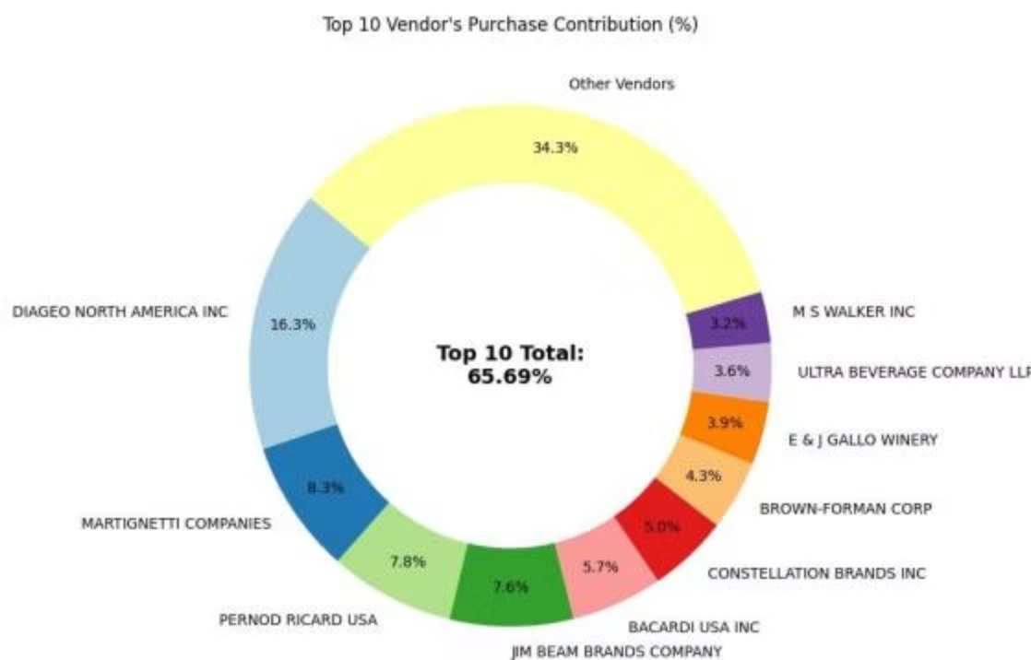
Vendor Concentration & Inventory Challenges
Top 10 Vendors Drive 65.69% of Purchases
DIAGEO NORTH AMERICA leads at 16.3%, followed by MARTIGNETTI COMPANIES (8.3%) and PERNOD RICARD USA (7.8%). This concentration presents both opportunity and risk.
$2.71M in Unsold Inventory
Slow-moving inventory increases storage costs and reduces cash flow efficiency. Top contributors to unsold inventory:
DIAGEO: $722.21K
JIM BEAM: $554.67K
PERNOD RICARD: $470.63K

Slide 9
CRITICAL ISSUES
Operational Risks Requiring Immediate Action
Loss-Making Transactions
Freight Inefficiencies
Low Turnover Vendors
Minimum Gross Profit: -$52,002.78
Range: $0.09 to $257,032.07
Stock Turnover: 0.62 - 0.81
Products actively sold at steep losses due to aggressive discounting below purchase cost. Pricing algorithms require immediate review.
Massive variance points to severe logistics inefficiencies or disproportionate bulk shipment costs requiring immediate auditing.
Vendors like ALISA CARR BEVERAGES (0.62) and HIGHLAND WINE MERCHANTS (0.71) contribute significantly to locked capital.

Slide 10




ACTION PLAN
Strategic Recommendations for Profit Maximization
Reallocate Marketing for "Target Brands"
Redirect advertising budgets toward the 198 low-volume, high-margin vendors in the 40%+ profit margin bracket. Increasing their sales volume will yield disproportionately higher gross profits.
Liquidate Dead Stock
Address the $2.71M in locked capital by identifying products with zero sales quantity. Implement aggressive bundling strategies or targeted discount campaigns to convert obsolete inventory back into liquid cash.
Audit Freight & Loss-Leaders
Immediately investigate logistics contracts causing $257K freight cost spikes. Halt or strictly review pricing algorithms allowing products to be sold at the -$52K maximum loss threshold.
Optimize Volume-Pricing Strategies
For high-volume vendors operating on thinner margins (~31%), explore selective incremental price adjustments or cost-optimization strategies to widen margins without sacrificing market share.

